Slide 1
NMR Spectroscopy

Slide 2
Theory of NMR
A spectroscopic technique that gives us information about the number and types of atoms in a molecule.
Nuclear magnetic resonance spectroscopy is a powerful analytical technique used to characterize organic molecules by identifying carbon-hydrogen frameworks within molecules.
Nuclear
Magnetic
Resonance
In the Nucleus
Involves Magnets
In the Nucleus

Slide 3
Two common types of NMR spectroscopy are used to characterize organic structure: 1H NMR is used to determine the type and number of H atoms in a molecule; 13C NMR is used to determine the type and number of C atoms in the molecule.
The source of energy in NMR is radio waves which have long wavelengths, and thus low energy and frequency.
When low-energy radio waves interact with a molecule, they can change the nuclear spins of certain atoms in presence of strong magnetic fields, including 1H and 13C.
All the atoms contains nuclei and all nuclei contains protons (+ve) charge in which some charge nuclei posses “Spin” on their own axis.

Slide 4
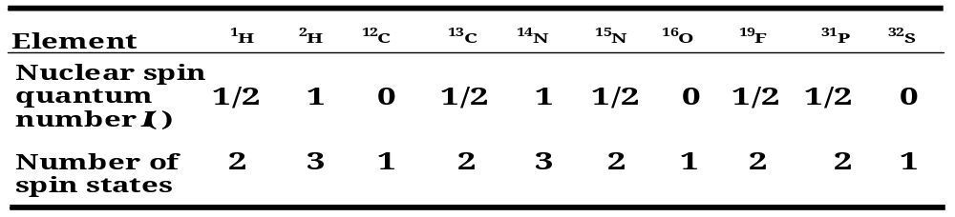
Spin nuclei are those which contains either Odd atomic number or odd atomic mass number or both e.g. 1H, 2H, 13C, 14N, 17O, 35Cl etc are useful for NMR.
Those nuclei contains Even number of atomic and mass number are not useful for NMR e.g. 12C, 16O etc.
The nuclei posses spin, they spin on their nuclear axis leads to generate magnetic dipole ‘µ’ so the angular momentum of this spinning charge is quantified and described by Quantum Spin Number “ I ”.

Slide 5
The individual protons have spin quantum number +1/2 or -1/2.
i.e. Hydrogen have spin quantum number (I) = +1/2 or -1/2.
These spin states have equal amount of energy (degenerated) in the absence of magnetic field.
When a charged particle such as a proton spins on its axis, it creates a magnetic field. Thus, the nucleus can be considered to be a tiny bar magnet.
+1/2
- 1/2
Fig. 1. Two spin states allowed for proton (H)

Slide 6
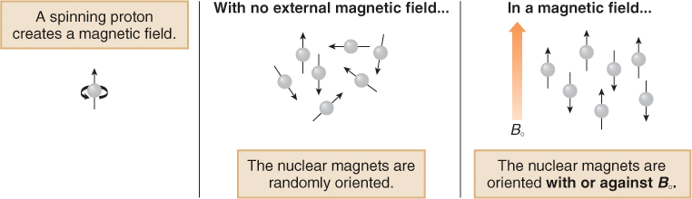
But when magnetic field is applied, the proton (H) posses spin & their own magnetic field align themselves either or opposite to magnetic field.
For e.g. 1H has +1/2 & -1/2 spin state, the proton (H) have +1/2 spin state align themselves with field (Lower energy) and with -1/2 spin state align opposite to field (Higher energy).

Slide 7
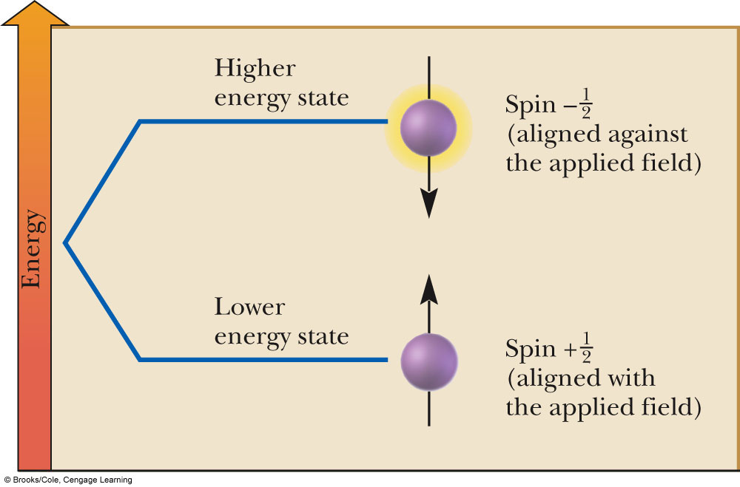
Fig.2. Change in spin state energy separation with increase by applied magnetic
field, B₀

Slide 8
Stronger the applied magnetic field, greater will be the difference between the spin state, ∆E = f(B₀) eq. ------1
As E_{absorbed} (∆E) = difference in energy levels of two energy states = hv.
Each nucleus depending on its charge and mass has its own magnetogyric ratio ‘Ý’ which is ratio of magnetic dipole moment to angular momentum, and it constant for each nucleus, therefore,
∆E = f(ÝB₀) = hv ------------2
∆E = Ý(h/2πB₀) = hv --------3
v = (Ý/2π) B₀ ----------------4
Here, v is frequency of electromagnetic radiation.

Slide 9
Precessional frequency:- May be defined as revolutions per second made by the magnetic moment vector of the nucleus around the external magnetic field Bo & Alternatively precessional frequency of spinning bar magnet may be defined as equal to the frequency of EMR in megacycles per second necessary to induce a transition from one spin state to another spin state.
The energy required to bring transition in NMR (∆E = hv) or to flip proton depends upon the strength of external magnetic field.
So, stronger the field greater will be the tendency of nucleus magnet to remain lined up with it and higher will be the frequency of radiation needed to flip proton to higher energy state.

Slide 10
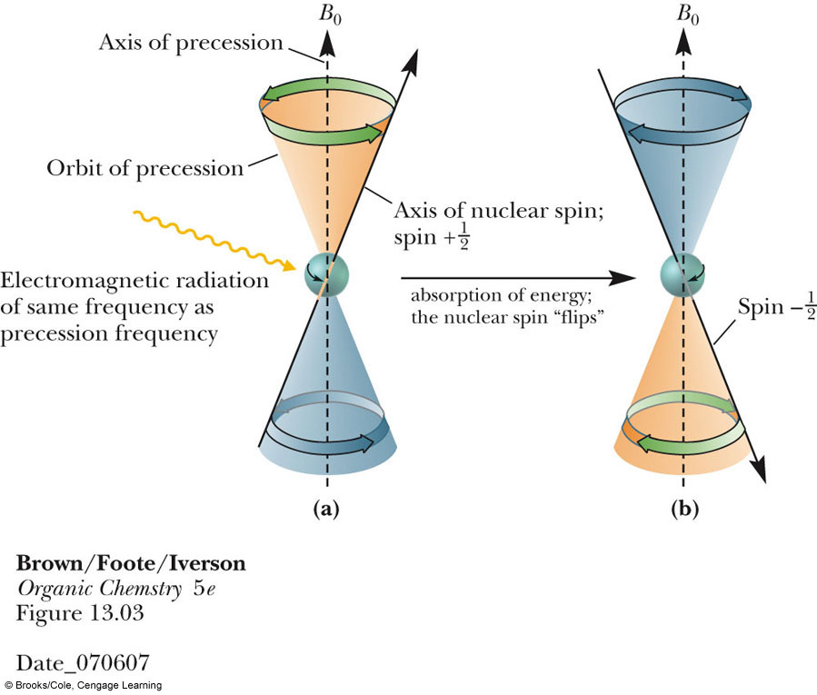
Nuclear Magnetic Resonance
NMR is phenomenon which occurs when those nuclei which are aligned with applied magnetic field are induce to absorb energy and change their spin state to opposite state, it is called as resonance.
Fig. 3. shows

Slide 11
The proton (Nucleus) +ve charge particle generates an magnetic field on its axis with same frequency as that of applied magnetic field, is called precessional frequency.
The frequency of precession (proton) is directly proportional to the strength of applied magnetic field.
If the precessing nucleus is irradiated with electromagnetic radiation of the same frequency as that frequency of precession nucleus, then
  The two frequencies couple
  Energy is absorbed
  The nuclear spin is flipped from spin state +1/2 (with the applied field) to -1/2 (against the applied field).

Slide 12
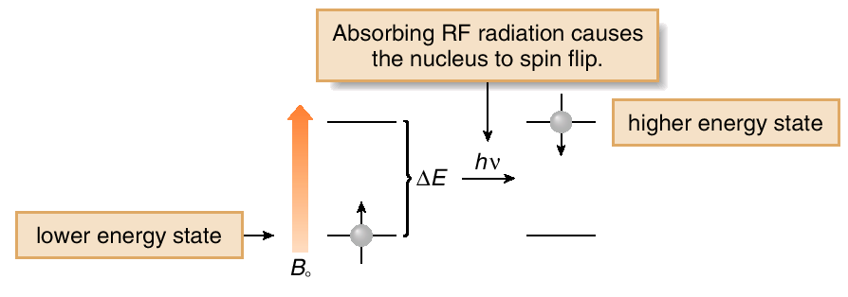
Fig.4. A nucleus is in resonance when it absorbs RF radiation
and spin flips to higher energy states.

Slide 13
Instrumentation
The NMR spectrophotometer consists of following components;
A magnet
Sample and sample holder
Radiofrequency generator
Detector
Recorder
In NMR spectrophotometer, the sample is dissolved in CDCl₃ and placed in magnetic field. Then radiofrequency generator irradiates the sample with short pulse of radiation causing resonance. When nuclei fall back to their low energy state, detector measures the energy released and spectrum is recorded. The superconducting magnet in modern NMR spectrometers have coils that are cooled in liquid helium and conduct electricity with no resistance.

Slide 14
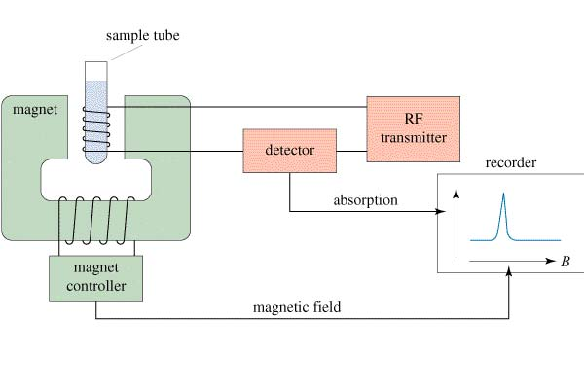
A line diagram of NMR spectrophotometer along with its components are as follows;

Slide 15
Magnet:- A strong magnet provides stable and homogenous field. The magnet size is 15 inches in diameter and capable of producing strong fields up to 23,500 gauss for 100MHz.
Sample and sample holder:- A 1 – 30 mg sample is used in the form of dilute solution (2 – 10%) and solvent doesn’t contain hydrogen of its own ions. The sample holder is glass tube about 5mm in diameter and 15 – 20 cm in length.
Radiofrequency oscillator:- The RF oscillator is installed perpendicular to magnetic field and transmits radio waves of some mixed frequency such as 60, 100, 220, 300 MHz. a sweep generator is installed to supply dc current to sec. magnet.

Slide 16
RF detector or Receiver:- It is installed perpendicular to both magnetic field and the oscillator coil and is tuned to the same frequency as transmitter. When precession frequency is match with RF the nuclei induces (emf) in detector coil and this signal is amplified and sent to recorder.
Recorder :- The recorder gives a spectrum as a plot of strength resonance signal on Y axis & strength of magnetic field on X axis. The strength of resonance signal is directly proportional to number of nuclei resonating at that particular field strength.

Slide 17
Working of instrument
Sample placed in long cylindrical glass tube especially made for NMR.
Dissolved the sample in proton free solvent like CDCl3 or CCl4 and add small amount of TMS as internal reference.
Placed the sample in gap between two magnetic poles where coil is attached to a specific RF generator (e.g. 60 MHz).
This coil supply EMR energy required to change spin orientation of proton.
Then detector coil detects radiofrequency signal when resonance occurs.
As magnetic field strength increase, the precessional frequency of all protons increase and when this frequency proton reaches

Slide 18
60 MHz, the resonance occurs.
So, as magnetic field increase linearly the recorder pen travels from left to right, thus protons which achieve resonance faster i.e. (Deshielded) appears on left side (downfield), where as those protons (Shielded) appears on right side (upfield) of chart in the form of peaks.
TMS is shown at a peak value of δ = 0 ppm.

Slide 19
Solvents
The solvent used for dissolving sample should have following properties;
Should not contain proton,
Inexpensive
Low boiling point and non polar in nature.
Generally deuterated chloroform CDCl₃ is used as solvent.
If sample is soluble in polar solvent, then deuterium oxide (D₂O), DMSO, CCl₄, CS₂, Cf₃, COOH are used as solvent.

Slide 20
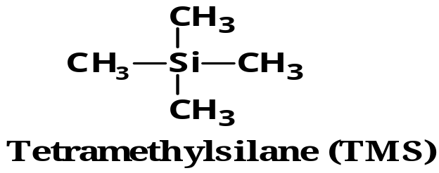
Internal Standard
But TMS (Tetra methyl silane) is most commonly used as IS for measuring the position of 1H, 13C and 29Si in NMR spectroscopy. Due to following reasons;
It is chemically inert and miscible with a large range of solvents.
Its twelve protons are all magnetically equivalent.
Its protons are highly shielded and gives a strong peak even small quantity.
It is less electronegative than carbon.
It is highly volatile and can be easily removed to get back sample.
It does not take part in intermolecular associations with sample.

Slide 21
Its resonance position is far away from absorptions due to protons in most organic molecules, thus signals of TMS = 0.

Slide 22
Chemical Shift (Position of Signals)
The utility of NMR is that all protons do not show resonance at same frequency boz, it is surrounded by particular no. of valence electrons which vary from atom to atom so, they exist in slightly different electronic environment from one another.
Position of signals in spectrum help us to know nature of protons i.e. aromatic, aliphatic, acetylinic, vinylic, adjacent to electron releasing or withdrawing grp. Thus they absorb at different field strength.
When molecule placed in magnetic field, so its surrounding electron circulate & generates counter field which opposes the applied magnetic field on proton so that, field feels by proton is reduced and that proton called as the Shielded proton.

Slide 23
Rotation of electrons (π) to nearby nuclei generate field that can either oppose or strong the field on proton.
If magnetic field is oppose applied magnetic field on proton, that proton said shielded proton and if field is strong the applied field then, proton feels high magnetic field strength and such proton called as Deshielded proton.
So, shielded proton shifts absorption signal to right side (upfield) and deshielded proton shifts absorption signal to left side (down field) of spectrum.
So, electric environment surrounding proton tells us where proton shows absorption in spectrum.

Slide 24
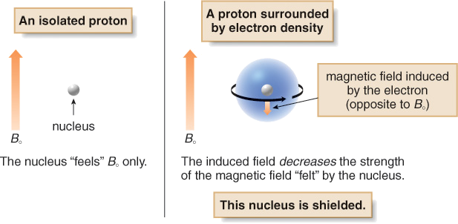
Such shifting in position of NMR absorption signals which arise due to the shielding or deshielding of proton by surrounding electrons are called as Chemical shift.

Slide 25
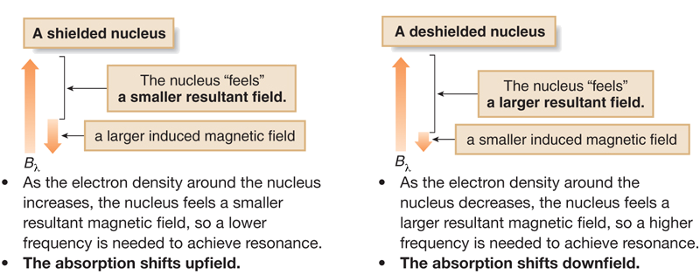
Shielding or Deshielding Protons In Molecule
As we have seen, depending on electronic environment protons in molecules are shielded or deshielded by different amounts.

Slide 26
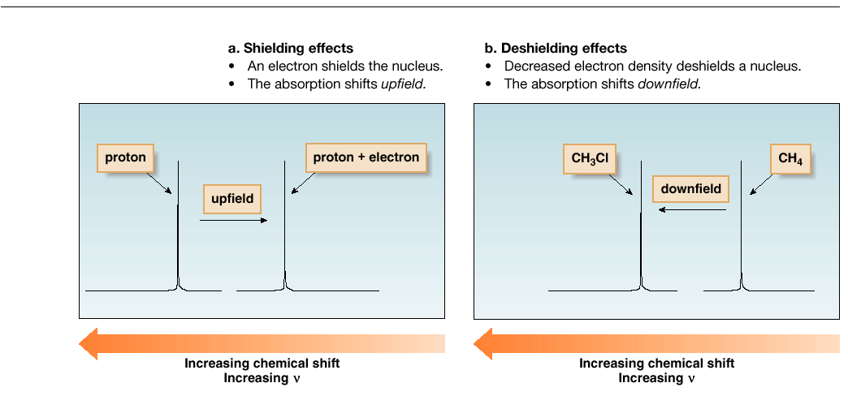
So, shielded proton shows absorption of signals to right side and deshielded protons at left side of spectrum.

Slide 27
For measuring chemical shifts of various protons in a molecule, the signal of TMS is taken as reference, due to low electro- negativity of Si atom and shielding of equivalent protons gives 1 NMR signal is greater than most of organic compounds.
The nmr signal for particular protons will appear at different field strength compared to signal from TMS.
This difference in the absorption position of the proton with respect to TMS signal is called as chemical shift (δ – value).
In majority of organic compound, protons resonate at lower field than protons of TMS boz, its signals appears at the extreme right side of spectrum, thus assigning delta (δ) value for TMS equal to zero (0).

Slide 28
Any proton or set of protons which absorb at lower field than TMS is given a positive value for (δ).
The value of δ for a substance w.r.p to TMS can be obtained by
Chemical shift, ppm δ = Shift downfield from TMS (in Hz)
Spectrometer frequency (in MHz)
The value of chemical shift, δ expressed in ppm and their value is between 0 to 10 in the δ scale.
In the τ scale, signal for standard reference, TMS taken as 10 ppm.
The two scales are related by the expression
  τ = 10 - δ

Slide 29
Chemical shift depends upon following parameters:
Electro negativity of nearby atoms
Hybridization of adjacent atoms
Diamagnetic effects from adjacent pi bonds

Slide 30
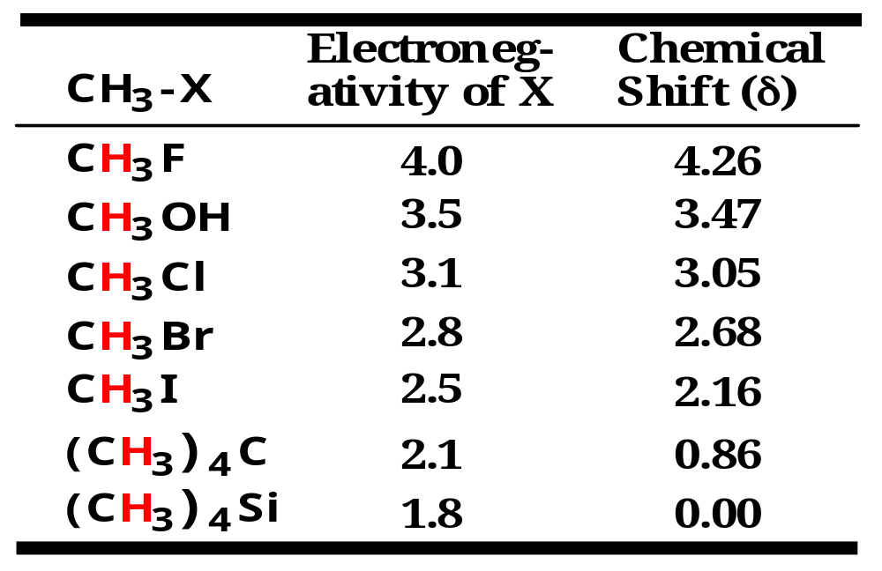
Electro negativity of nearby atoms

Slide 31
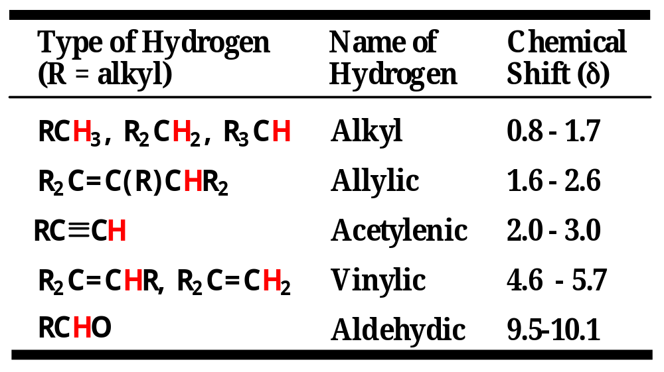
Hybridization of adjacent atoms

Slide 32
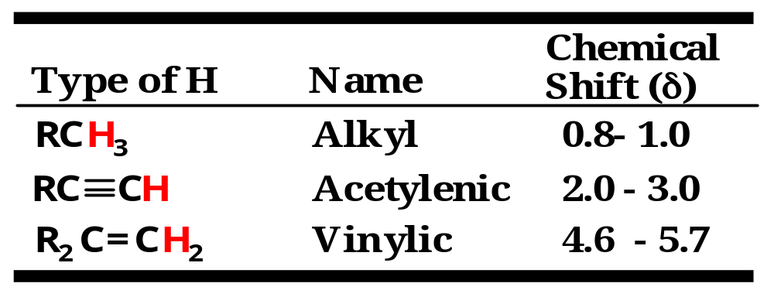
Diamagnetic effects from adjacent pi bonds
  A carbon-carbon triple bond shields an acetylenic hydrogen and shifts its signal to lower frequency (to the right) to a smaller δ value.
  A carbon-carbon double bond deshields vinylic hydrogens and shifts their signal to higher frequency (to the left) to a larger δ value.

Slide 33
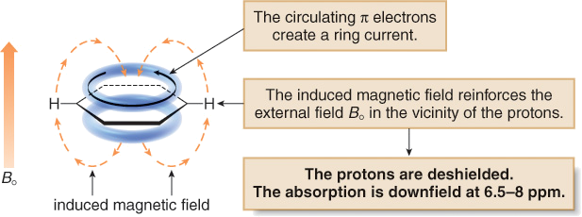
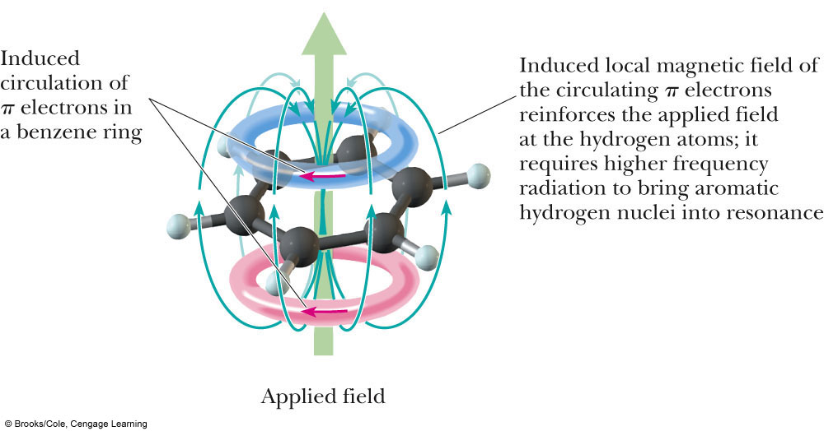
Chemical Shift Values (Benzene)
In a magnetic field, the six π electrons in benzene circulate around the ring creating a ring current.
The magnetic field induced by these moving electrons reinforces the applied magnetic field in the vicinity of the protons.
The protons thus feel a stronger magnetic field and a higher frequency is needed for resonance. Thus they are deshielded and absorb downfield.

Slide 34
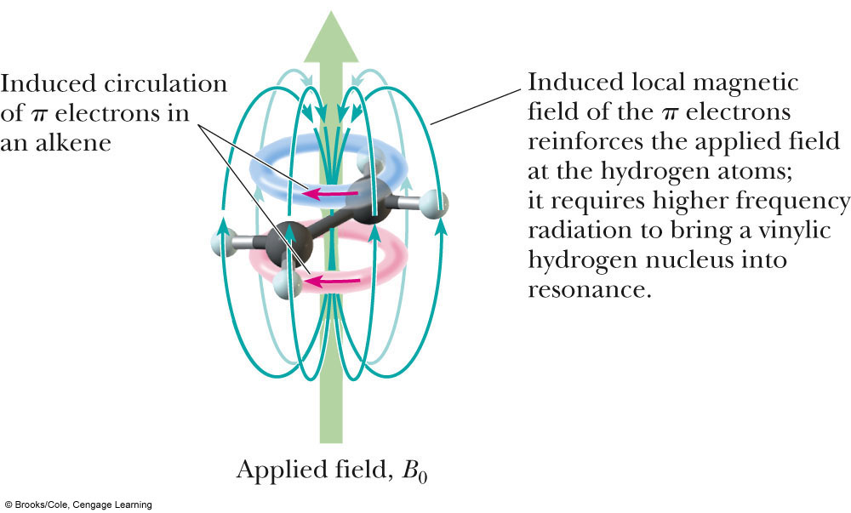
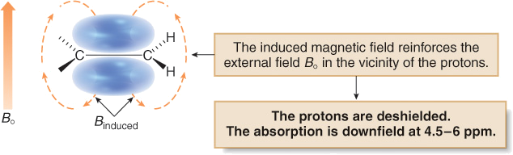
In a magnetic field, the loosely held π electrons of the double bond create a magnetic field that reinforces the applied field in the vicinity of the protons.
The protons now feel a stronger magnetic field, and require a higher frequency for resonance. Thus the protons are deshielded and the absorption is downfield.

Slide 35
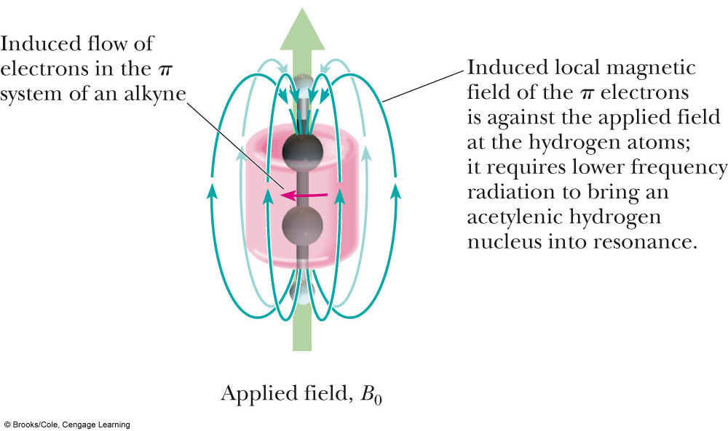
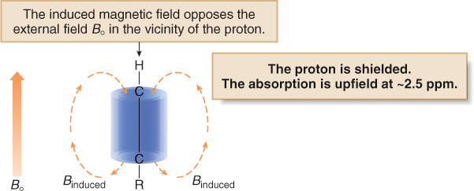
In a magnetic field, the π electrons of a carbon-carbon triple bond are induced to circulate, but in this case the induced magnetic field opposes the applied magnetic field.
Thus, the proton feels a weaker magnetic field, so a lower frequency is needed for resonance. The nucleus is shielded and the absorption is upfield.

Slide 36
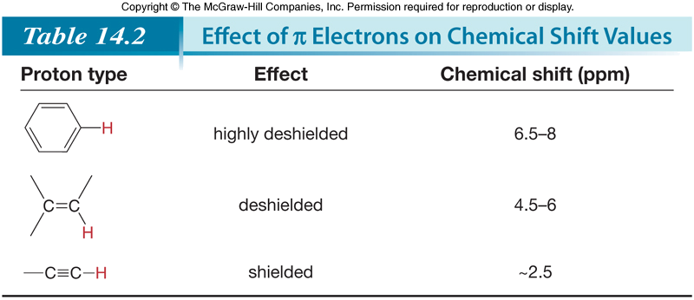

Slide 37
Factors affecting chemical shift
Following are the factors which influence the chemical
shift;
Inductive effect
Van der Waal’s deshielding
Anisotropic effect
Hydrogen bonding

Slide 38
Spin-Spin Splitting in NMR Spectrum
Peaks are often split into multiple peaks due to magnetic interactions between nonequivalent protons on adjacent carbons, The process is called Spin-spin Splitting/Coupling.
Spin-spin splitting: It occurs only between nonequivalent protons on the same carbon or adjacent carbons.
Peak: The units into which an NMR signal is split; doublet, triplet, quartet, multiplet, etc.
Signal splitting: Splitting of an NMR signal into a set of peaks by the influence of neighboring nonequivalent hydrogens.
Signal coupling: An interaction in which the nuclear spins of adjacent atoms influence each other and lead to the splitting of NMR signals.

Slide 39
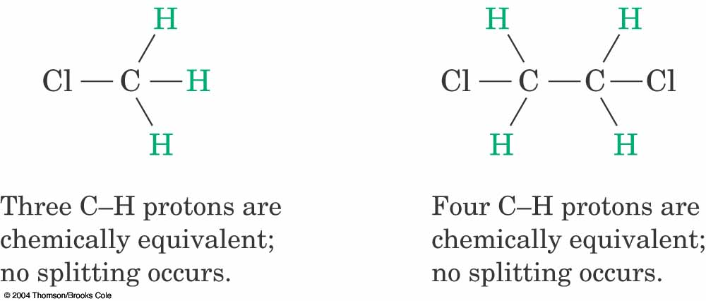
Equivalent & Nonequivalent Protons
Equivalent protons are like this;
These equivalent protons do not split each other.
Protons bonded to the same carbon will split each other only if they are not equivalent.
Equivalent protons have the same chemical shift.

Slide 40
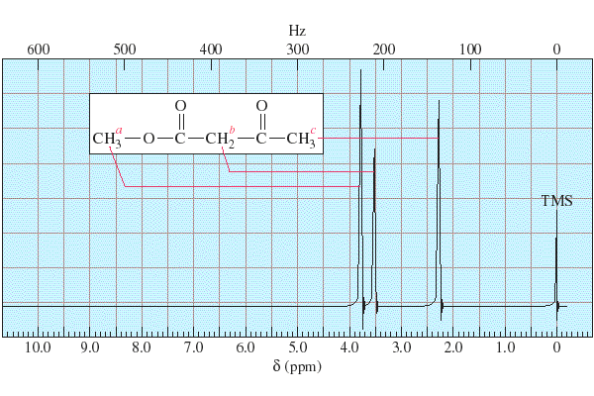
Equivalent protons have same chemical shift without splitting
occurs

Slide 41
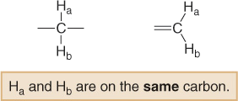
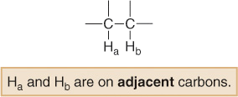
Nonequivalent protons are like this;
If Ha and Hb are not equivalent, the splitting is observed.
Nonequivalent protons on adjacent carbons have magnetic fields that may align with or oppose the external field.
This magnetic coupling causes the proton to absorb slightly downfield when the external field is reinforced and slightly upfield when the external field is opposed.
All possibilities exist, so signal is split.

Slide 42
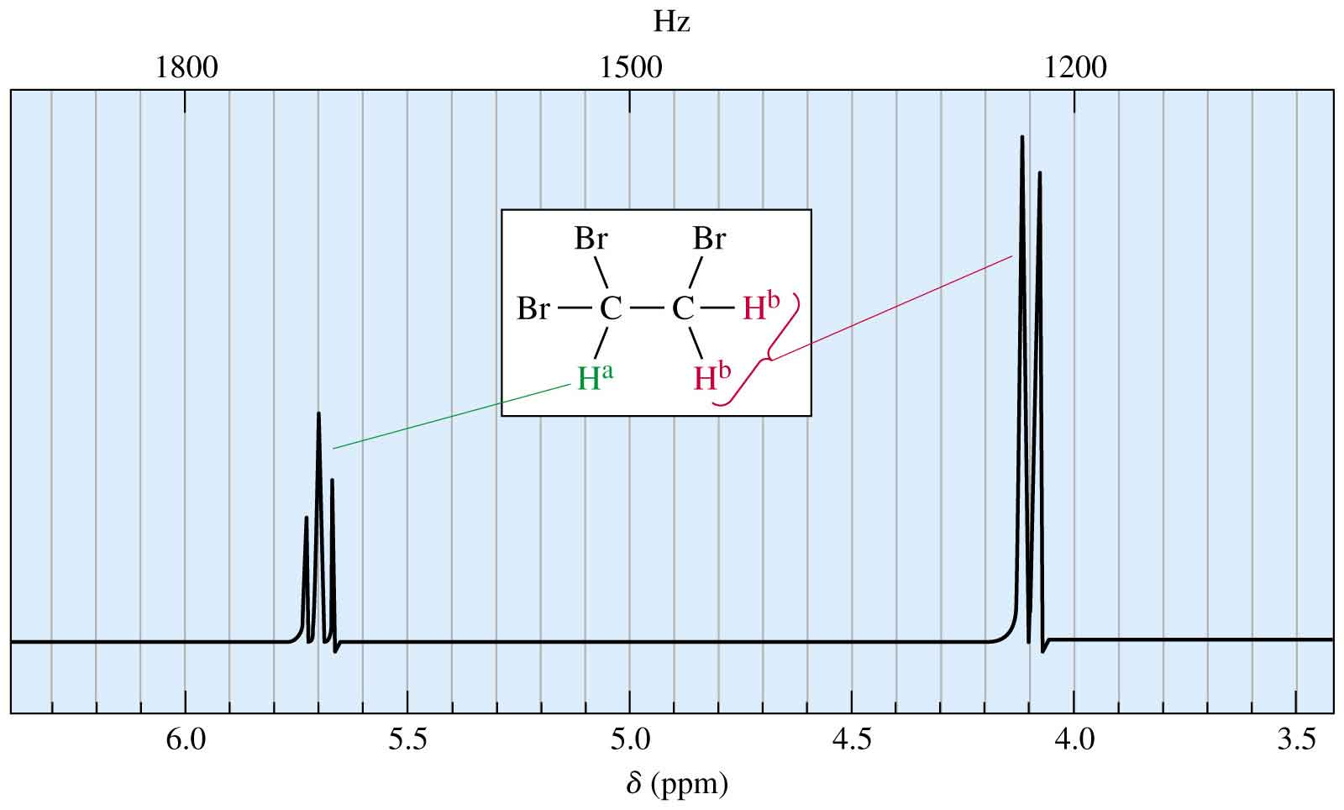
Non equivalent protons have different chemical shift with
splitting occurs

Slide 43
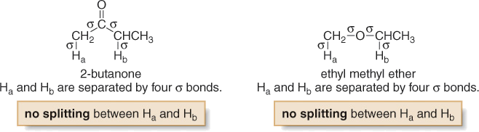
Splitting is not generally observed between protons separated by more than three σ bonds.

Slide 44
Peak: The units into which an NMR signal is split; doublet, triplet, quartet, multiplet, etc.
So now, let us consider how the doublet signal due to the CH₂ group on BrCH₂CHBr₂ occurs:
When placed in an applied field, (B₀), the adjacent proton (CHBr₂) can be aligned with (↑) or against (↓) B₀.
Thus, the absorbing CH₂ protons feel two slightly different magnetic fields—one slightly larger than B₀, and one slightly smaller than B₀.
Since the absorbing protons feel two different magnetic fields, they absorb at two different frequencies in the NMR spectrum, thus splitting a single absorption into a doublet, where the two peaks of the doublet have equal intensity.

Slide 45
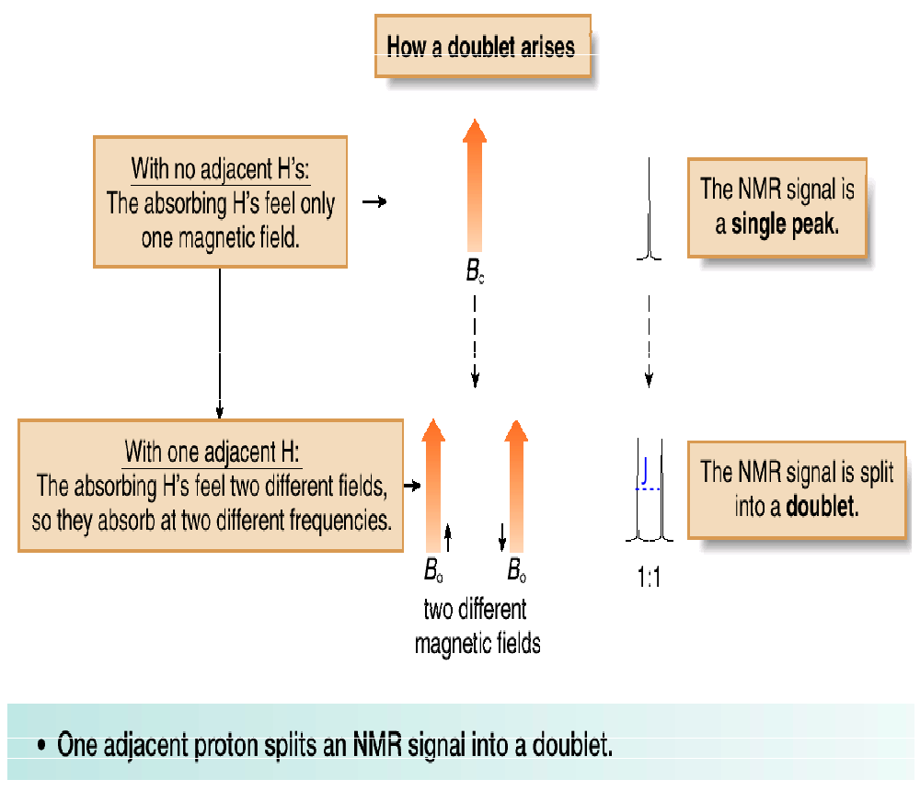
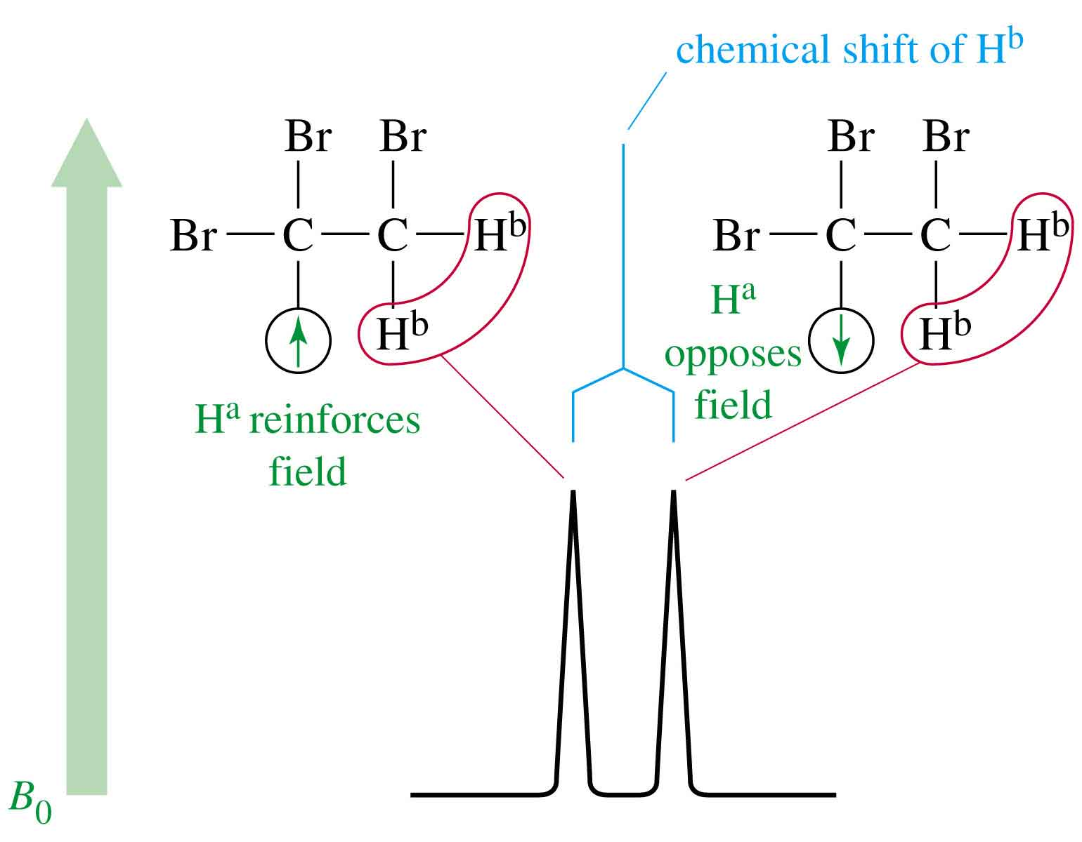
How doublet signal arises

Slide 46

Let us now consider how a triplet arises:
When placed in an applied magnetic field (B₀), the adjacent protons Ha and Hb can each be aligned with (↑) or against (↓) B₀.
Thus, the absorbing proton feels three slightly different magnetic fields—one slightly larger than B₀(↑a↑b). one slightly smaller than B₀(↓a ↓b) and one the same strength as B₀(↑a ↓b).

Slide 47
Because the absorbing proton feels three different magnetic fields, it absorbs at three different frequencies in the NMR spectrum, thus splitting a single absorption into a triplet.
Because there are two different ways to align one proton with B₀, and one proton against B₀—that is, ↑a↓b and ↓a↑b—the middle peak of the triplet is twice as intense as the two outer peaks, making the ratio of the areas under the three peaks 1:2:1.
Two adjacent protons split an NMR signal into a triplet.
When two protons split each other, they are said to be coupled.
The spacing between peaks in a split NMR signal, measured by the J value, is equal for coupled protons.

Slide 48
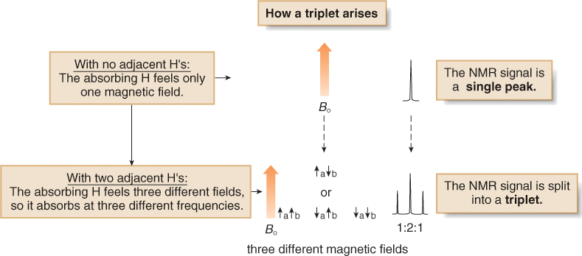
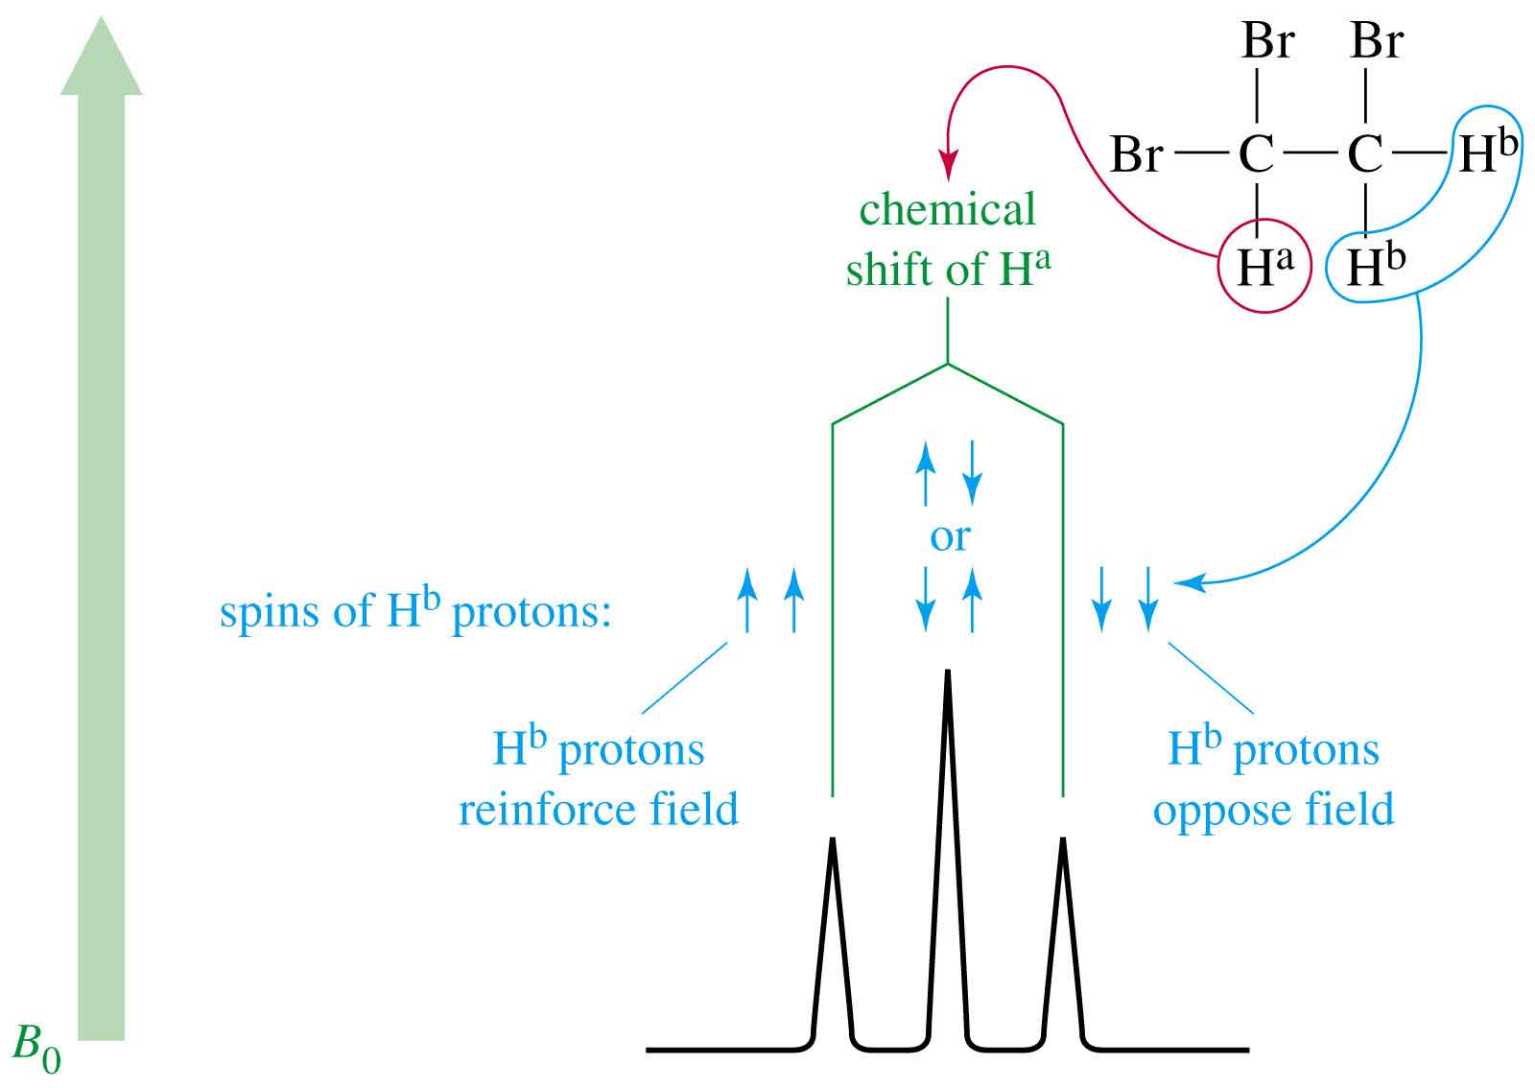
How triplet signal arises

Slide 49
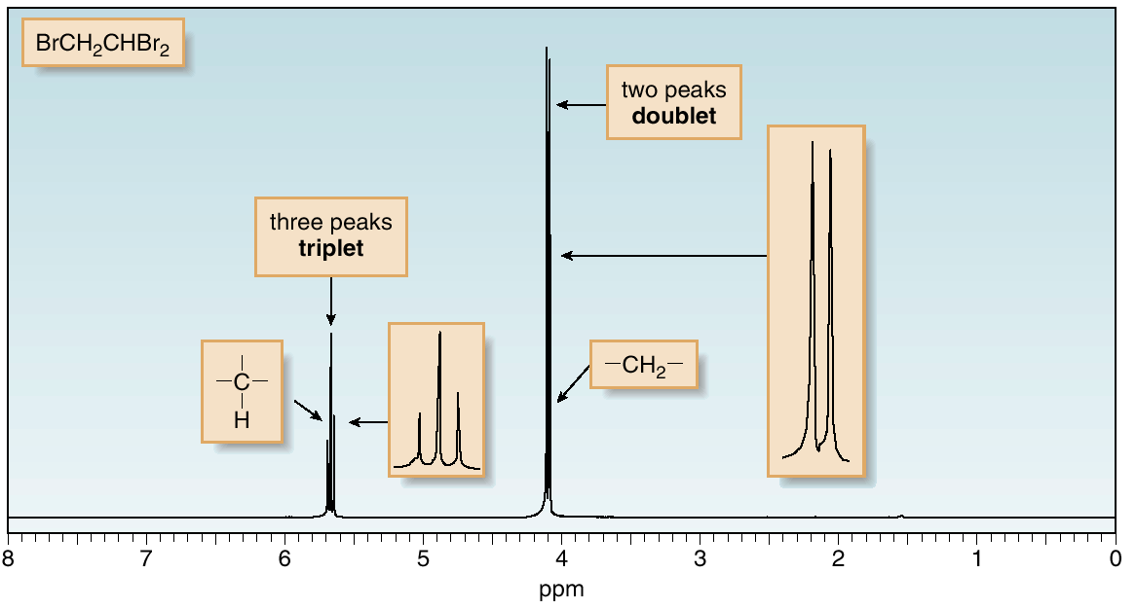
Doublet and triplet signals

Slide 50
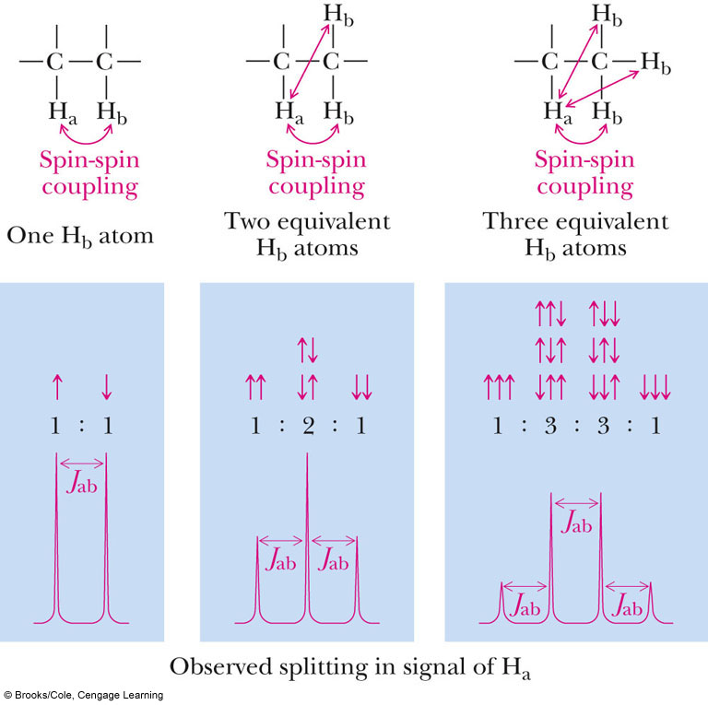
How quartet signal arises

Slide 51
Signal Splitting: The (n + 1) Rule
In a NMR spectrum all equivalent protons do not appear as a signal peak, e.g. 1,1,2 - tribromoethane which has two types of equivalent protons, thus it shows two peaks in NMR spectrum.
But the actual spectrum consists of two peaks but subdivided into 3 and 2 sub peaks or splitting one for (CH) and two for (CH₂Br) protons respectively.
This phenomenon of splitting of equivalent protons into (n + 1) rule, where n is the no. of equivalent protons attached to the adjacent carbon to which the protons under consideration is attached.
So as per the (n + 1) rule in 1,1,2- tribromoethane, the (C₁) has two equivalent protons of Methylene on the carbon next to it, therefore, n = 2 and hence it will split into (2+1) = 3 peaks (Triplet).

Slide 52
The Methylene protons are having n = 1 therefore, it will split (1+1) = 2 peaks (Doublet).

Slide 53
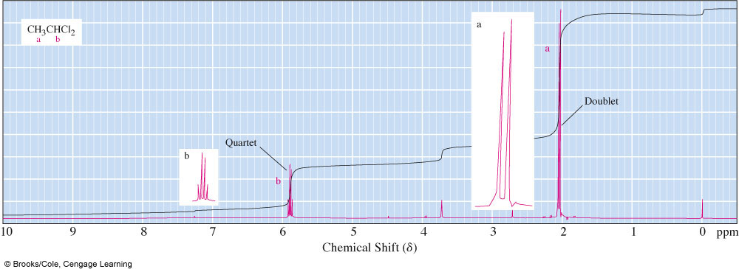
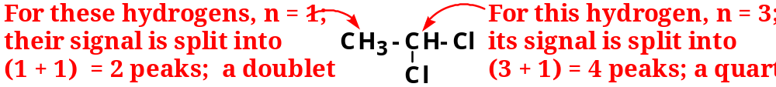
Another example

Slide 54
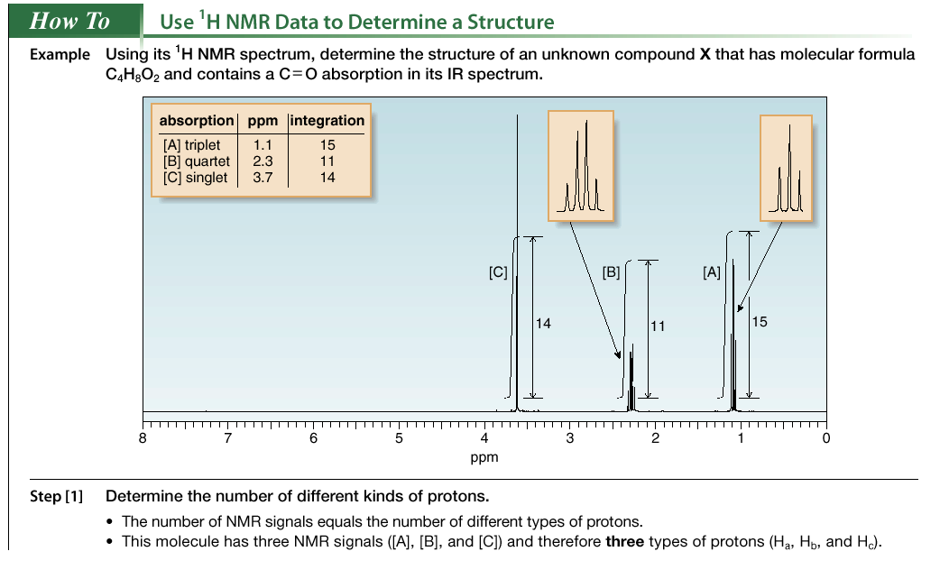
1H NMR—Structure Determination

Slide 55
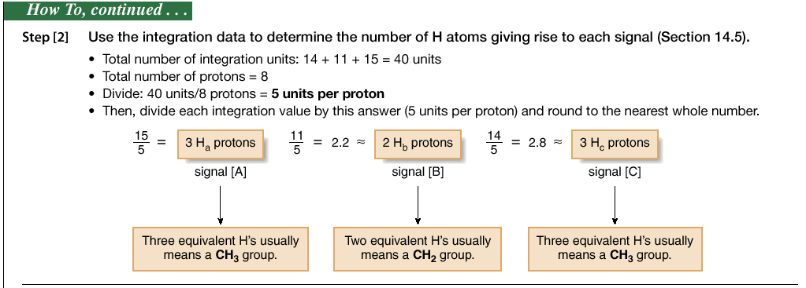

Slide 56
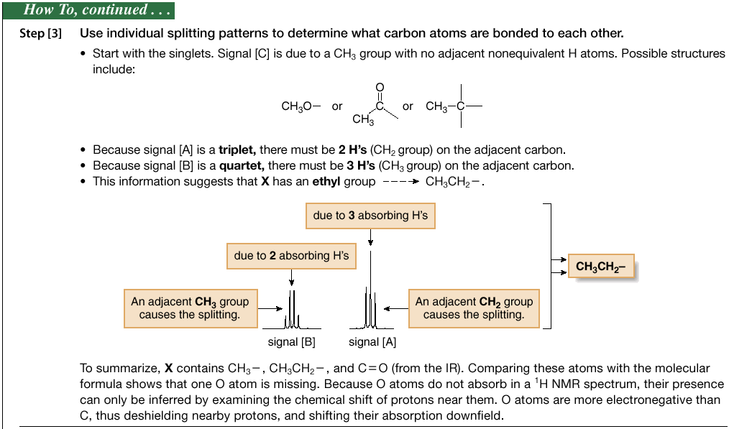

Slide 57
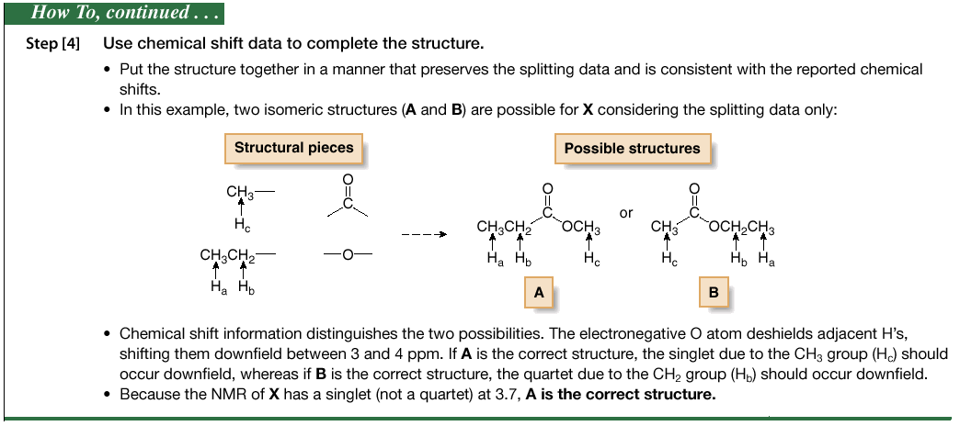

Slide 58
Applications of NMR Spectrum
Identification of structural isomers
Detection of hydrogen bonding
Detection of aromaticity
Distinction between Cis-trans isomers and conformers
Detection of electronegative atoms or group
Detection of some double bond character due to resonance

Slide 59
References:-
Elementary Organic Chemistry, Principles and Chemical Applications; by Y.R. Sharma, Pg.no: 180 – 237.
Basics Concepts in Pharmaceutical Research, by Bijiya Ghosh and Sonal Dubey; Pg. no: 160 – 175.

Slide 60


